Slide 1
Unit-3
Image compression –Chapter 8
Fundamentals, Basic methods, Digital image watermarking, Full motion video compression.

Slide 2
Image Compression- Fundamental
The term data compression refers to the process of reducing the amount of data required to represent a given quantity of information.
Data and information are not synonymous- In fact, data are the means by which information is conveyed. Various amounts of data may be used to represent the same amount of information.
Representations that contain repeated or irrelevant information are said to contain redundant data.
Data redundancy is a central issue in digital image compression.

Slide 3
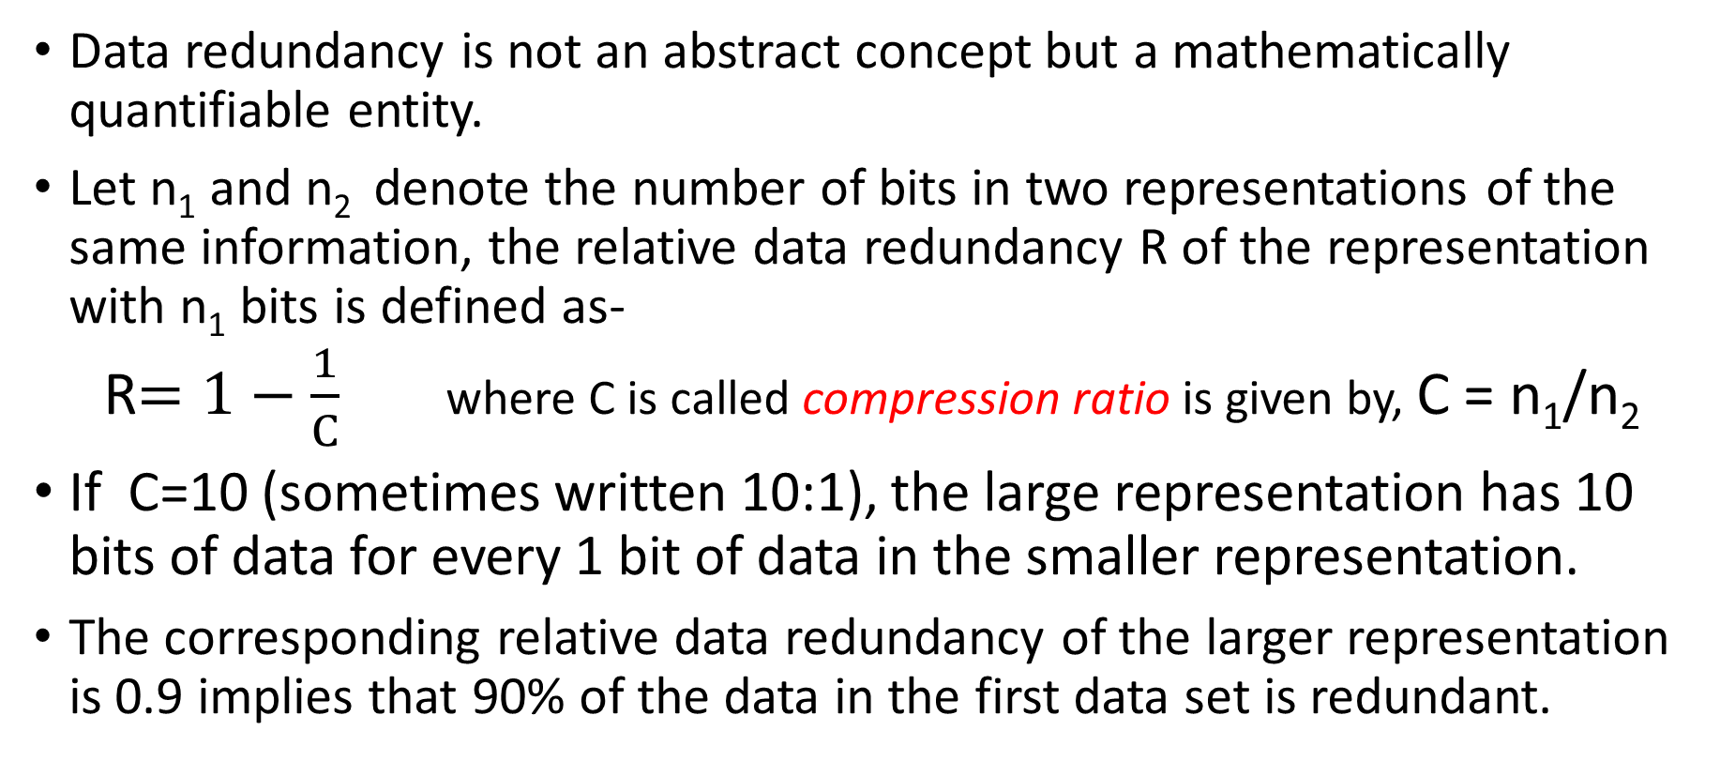
Data Redundancy

Slide 4
Data Redundancy
In digital image compression, three basic data redundancies can be identified and exploited:
Coding redundancy,
Interpixel redundancy (Spatial &temporal Redundancy)
psychovisual redundancy (irrelevant information)
Data compression is achieved when one or more of these redundancies are reduced or eliminated.

Slide 5
Coding Redundancy
Coding Redundancy-
A code is a system of symbols (letters, numbers, bits, etc) used to represent a body of information or set of events.
Each piece of information of events is assigned a sequence of code symbols called a code word.
The no of symbols in each code word is its length .
In this, we utilize formulation to show how the gray-level histogram of an image also can provide a great deal of insight into the construction of codes to reduce the amount of data used to represent it.

Slide 6
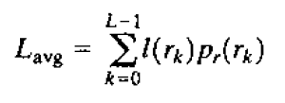
Coding Redundancy
Let us assume, that a discrete random variable r_{k} in the interval- [0, L-1] represents the intensities of an M X N image and that each r_{k} occurs with probability p_{r}(r_{k}) –
p_{r}(r_{k}) = n_{k}/MN k=0,1,2,……,L-1 ,
Where L is the no of intensity values and n_{k} is the number of times that the kth intensity appears in the image
If the number of bits used to represent each value of r_{k} is l(r_{k}), then the average number of bits required to represent each pixel is -
That is, the average length of the code words assigned to the various intensity values is found by summing the product of the number of bits used to represent each intensity and the probability that the intensity occurs.
Thus the total number of bits required to code an M X N image is MNL_{avg}

Slide 7
Coding Redundancy
Fixed length code-
If the intensities are represented using a natural m bit fixed length code, the right hand side of equation reduces to m bits.
That is L_{avg}=m when m is substituted for l(r_{k}).
The constant m can be taken outside the summation, leaving only the sum of the p_{r}(r_{k}) for 0 ≤ k ≤ L-1, which is 1.

Slide 8
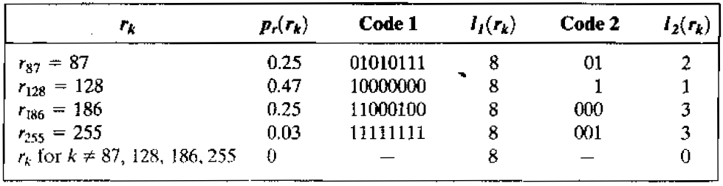
Example- variable length coding
The intensity distribution is shown in second column for an image.
If a natural 8 bit binary code is used to represent its 4 possible intensities, L_{avg} the average number of bits for code 1 – is 8 bits, because l(r_{k}) i= 8 for all r_{k}.
In code 2 scheme, the average length of the encoded pixel is –
L_{avg}= 0.25(2) + 0.47(1) + 0.25(3) + 0.03(3) = 1.81 bits
The total no of bits needed to represent the entire image is MNL_{avg}=256 X 256 X 1.81=118621

Slide 9
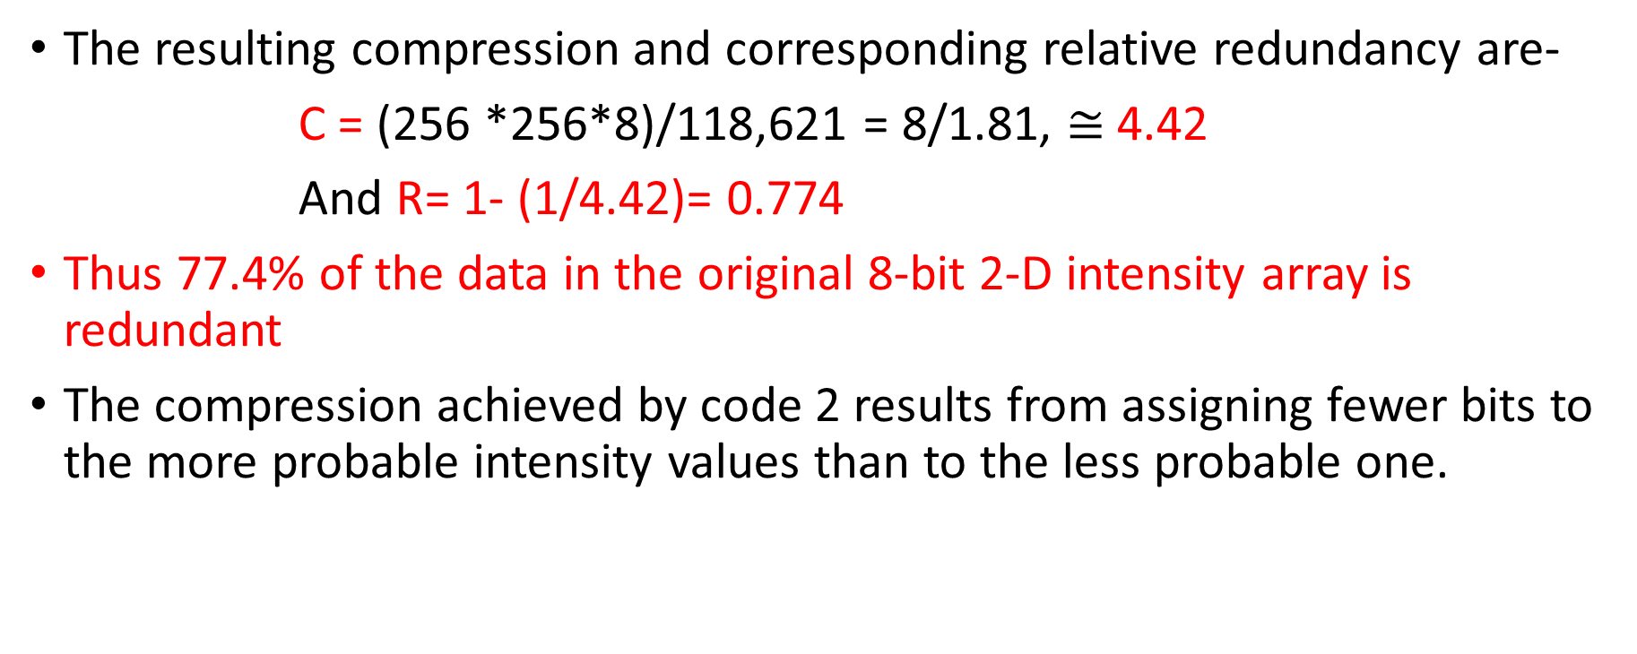
Example variable length coding

Slide 10
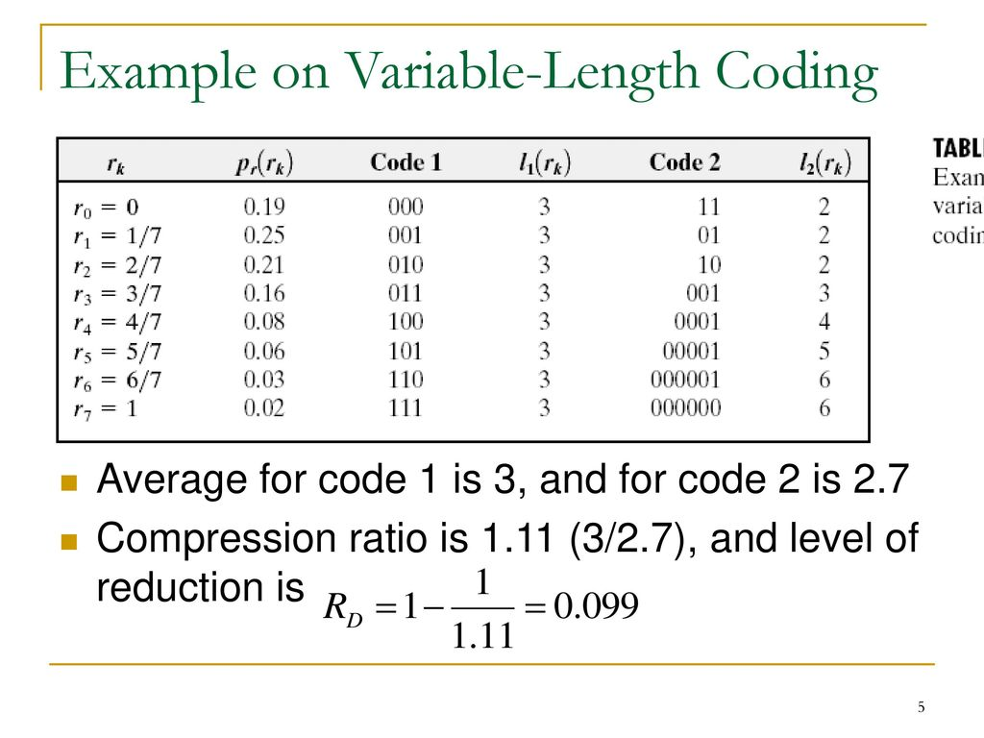

Slide 11
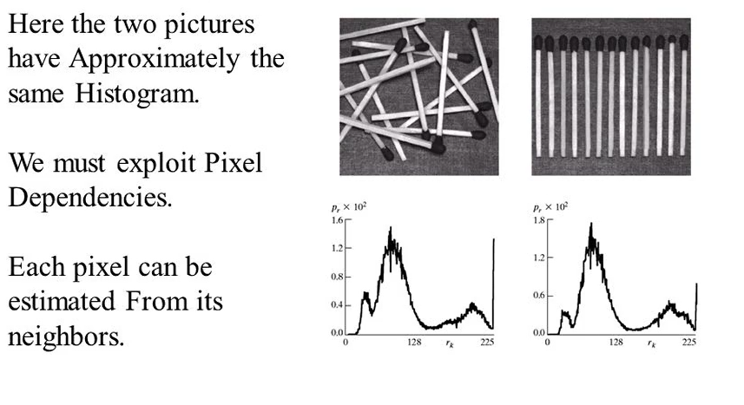
Interpixel - Spatial and temporal redundancy

Slide 12
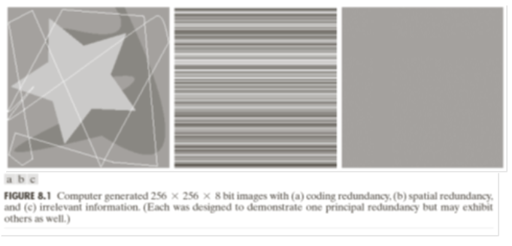
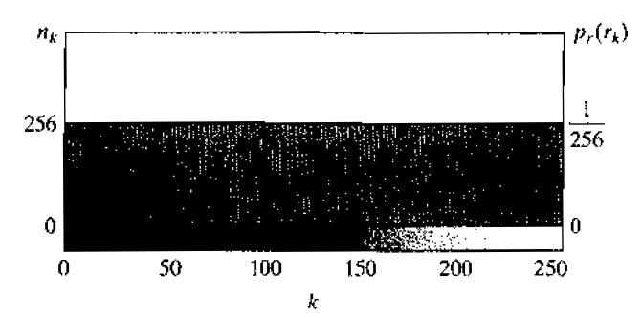
Interpixel - Spatial and temporal redundancy
In fig 8.1b(b)-
All 256 intensities are equally probable as the histogram of the image is uniform.
The pixels along each line are identical, they are maximally correlated (depend on each other) in horizontal direction
We can observe a significant spatial redundancy that can be eliminated by representing the image as a sequence of run length pair.
Histogram

Slide 13
Run length coding
What is run length coding?
Run-length Encoding, or RLE is a technique used to reduce the size of a repeating string of characters. This repeating string is called a run; typically RLE encodes a run of symbols into two bytes, a count and a symbol.
Where each Run Length Pairs specifies the start of new intensity and the number of consecutive pixels that have that intensity.
Each pair consists of:
Intensity values
Number of pixels that have this intensity value
Transformation of this type are called mapping.

Slide 14
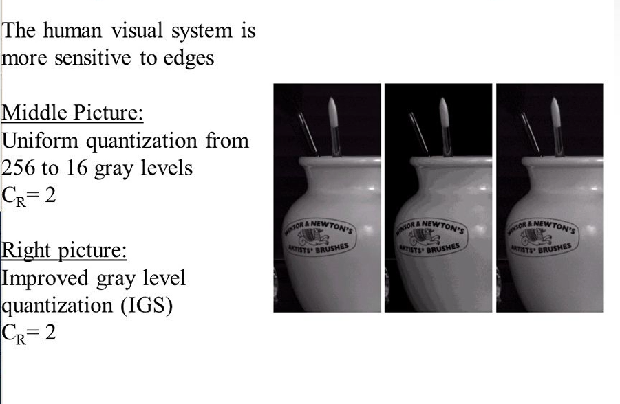
Irrelevant information- psychovisual redundancy
Informations that are ignored by human visual system or is extraneous to the intended use of an image are obvious candidates for omission.

Slide 15
Fidelity Criteria
The removal of psychovisually redundant data results in a loss of real or quantitative visual information.
Because information of interest may be lost, a repeatable or reproducible means of quantifying the nature and extent of information loss is highly needed.
Two general classes of criteria are used as the basis for such an assessment:
Objective fidelity criteria
Subjective fidelity criteria.

Slide 16
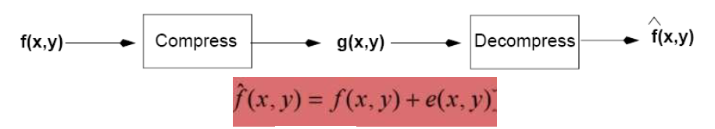
Fidelity Criteria
When lossy compression techniques are employed, the decompressed image will not be identical to the original image. In such cases, we can define fidelity criteria that measure the difference between this two images.
Objective fidelity criteria-
When the level of information loss can be expressed as a mathematical function of the original or input image and the compressed and subsequently decompressed output image, it is said to be based on an objective fidelity criterion.
A good example is the root-mean-square (rms) error between an input and output image.

Slide 17
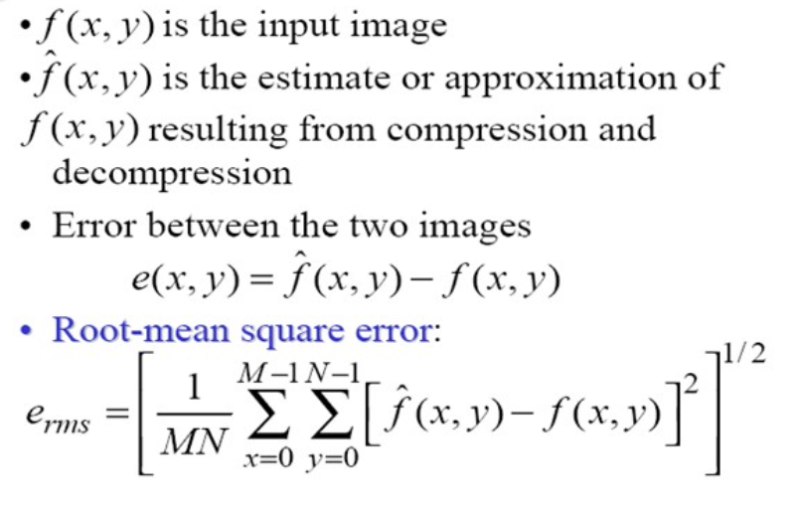
Objective fidelity criteria
Images are of size M * N.
The e_{rms} between two images is then the square root of the squared error averaged over the M*N array.

Slide 18
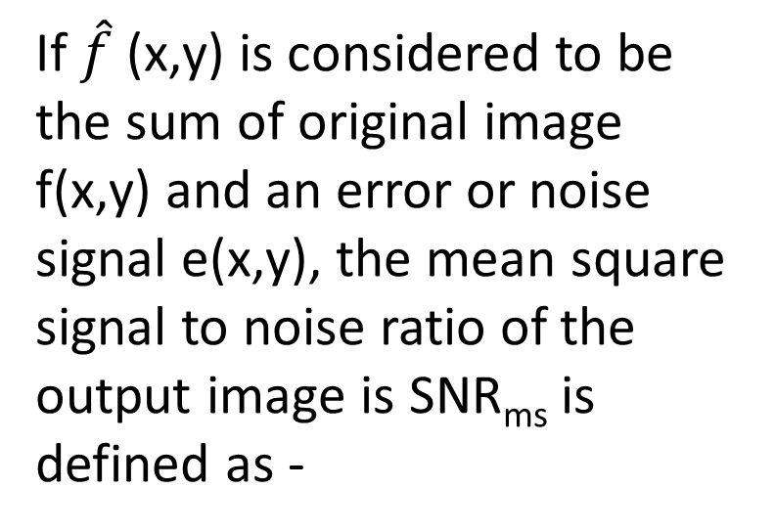
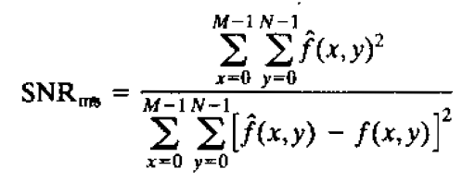
Objective fidelity criteria

Slide 19
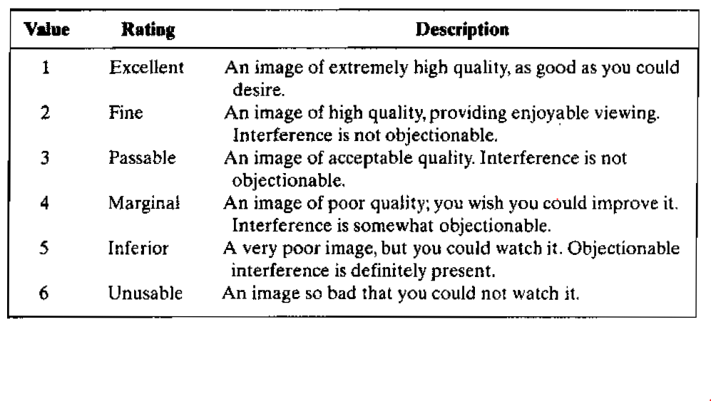
Subjective fidelity criteria
Although objective fidelity criteria offer a simple and convenient mechanism for evaluating information loss, most decompressed images ultimately are viewed by humans.
Consequently, measuring image quality by the subjective evaluations of a human observer often is more appropriate.

Slide 20
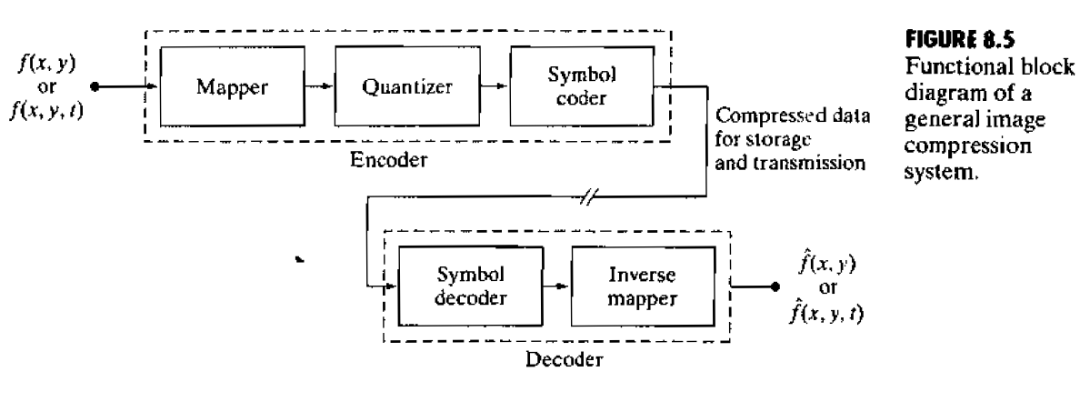
Image compression models
A compression system consists of two distinct structural blocks: an encoder and a decoder.

Slide 21
Image compression models
An encoder –
Encoder is responsible for reducing or eliminating any coding, interpixel or psychovisual redundancy.
The first block “Mapper” transforms the input data into a nonvisual format, designed to reduce interpixel redundancy. This operation generally is reversible and may or may not reduce directly the amount of data required to represent the image. For eg, run-length encoding
The quantizer reduces accuracy of the mapper output in accordance with some fidelity criterion. This stage reduces the psychovisual redundancies of the input image. This operation is irreversible. Thus it must be omitted when error-free compression is desired.
The symbol encoder creates a fixed or variable length codeword. The operation, of course, is reversible.
So, The source encoder is responsible for reducing or eliminating any coding, interpixel, or psychovisual redundancies in the input image.

Slide 22
Image compression models
A decoder-
The source decoder shown contains only two components: a symbol decoder and an inverse mapper.
These blocks perform, in reverse order, the inverse operations of the source encoder's symbol encoder and mapper blocks.
Because quantization results in irreversible information loss, an inverse quantizer block is not included in the general source decoder model

Slide 23
Compression Method- Huffman Coding
The most popular technique for removing coding redundancy is due to Huffman.
When coding the symbols of an information source individually, Huffman coding yields the smallest possible number of code symbols per source symbol.
The first step in Huffman's approach is to create a series of source reductions by ordering the probabilities of the symbols under consideration and combining the lowest probability symbols into a single symbol that replaces them in the next source reduction.

Slide 24
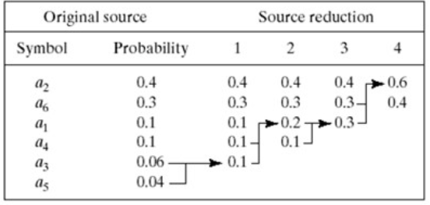
Huffman Coding – First step
At the far left, a hypothetical set of source symbols and their probabilities are ordered from top to bottom in terms of decreasing probability values.
To form the first source reduction, the bottom two probabilities, 0.06 and 0.04, are combined to form a "compound symbol" with probability 0.1.
This compound symbol and its associated probability are placed in the first source reduction column so that the probabilities of the reduced source are also ordered from the most to the least probable.
This process is then repeated until a reduced source with two symbols (at the far right) is reached.

Slide 25
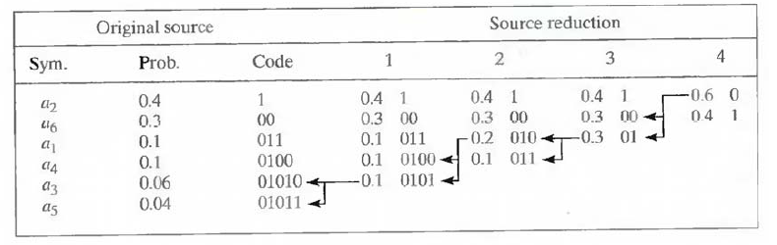
Huffman Coding – Second Step
The second step in Huffman's procedure is to code each reduced source, starting with the smallest source and working back to the original source.
The minimal length binary code for a two-symbol source, is the symbols 0 and 1.
These symbols are assigned to the two symbols on the right (the assignment is arbitrary; reversing the order of the 0 and 1 would work just as well).
As the reduced source symbol with probability 0.6 was generated by combining two symbols in the reduced source to its left, the 0 used to code it is now assigned to both of these symbols, and a 0 and 1 are arbitrarily appended to each to distinguish them from each other.
This operation is then repeated for each reduced source until the original source is reached.

Slide 26
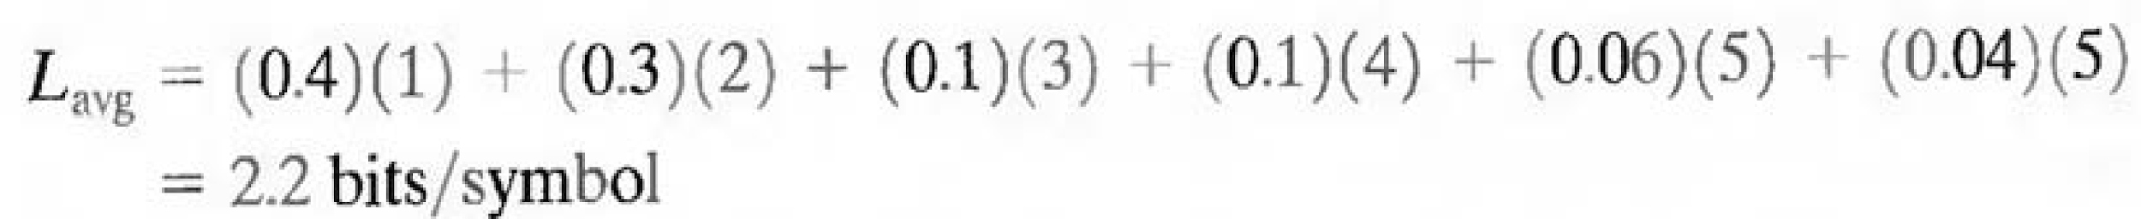
Huffman Coding
The average length of this code is-

Slide 27
LZW Compression Coding
Its an error free compression technique that also address spatial redundancies in an image.
The technique, called Lempel-Ziv-Welch (LZW) coding, assigns fixed-length code words to variable length sequences of source symbols.
It does not requires priori knowledge of the probability of occurrence of the symbols to be encoded.
LZW compression has been integrated into a variety of mainstream imaging file formats, including the graphic interchange format (GIF), tagged image file format (TIFF), and the portable document format (PDF).
https://youtu.be/2FjOJMelZe0

Slide 28
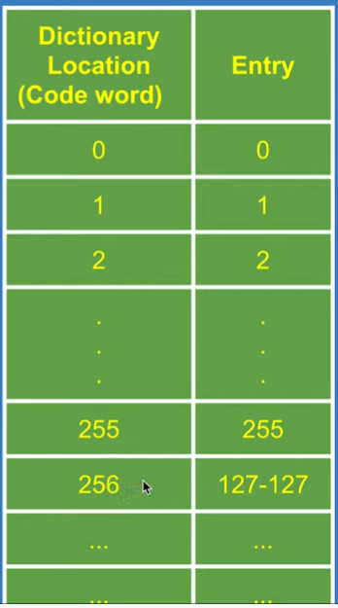
LZW Compression Coding
At the onset of the coding process, a codebook or "dictionary" containing the source symbols to be coded is constructed.
Dictionary is adaptive to the data.
For 8-bit monochrome images, the first 256 words of the dictionary are assigned to the gray values 0, 1, 2..., and 255.
LZW encoder sequentially examine the image’s pixels, Gray level sequence that are not in the dictionary are placed in algorithmically determined (e.g., the next unused) locations.

Slide 29
LZW Compression Coding
If the first two pixels of the image are white, for instance, sequence “255- 255” might be assigned to location 256, the address following the locations reserved for gray levels 0 through 255.
The next time that two consecutive white pixels are encountered, code word 256, the address of the location containing sequence 255-255, is used to represent them.
If a 9-bit, 512-word dictionary is employed in the coding process, the original (8 + 8) bits that were used to represent the two pixels are replaced by a single 9-bit code word.

Slide 30
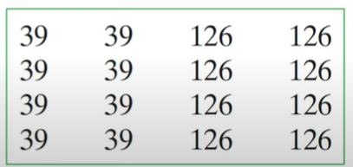
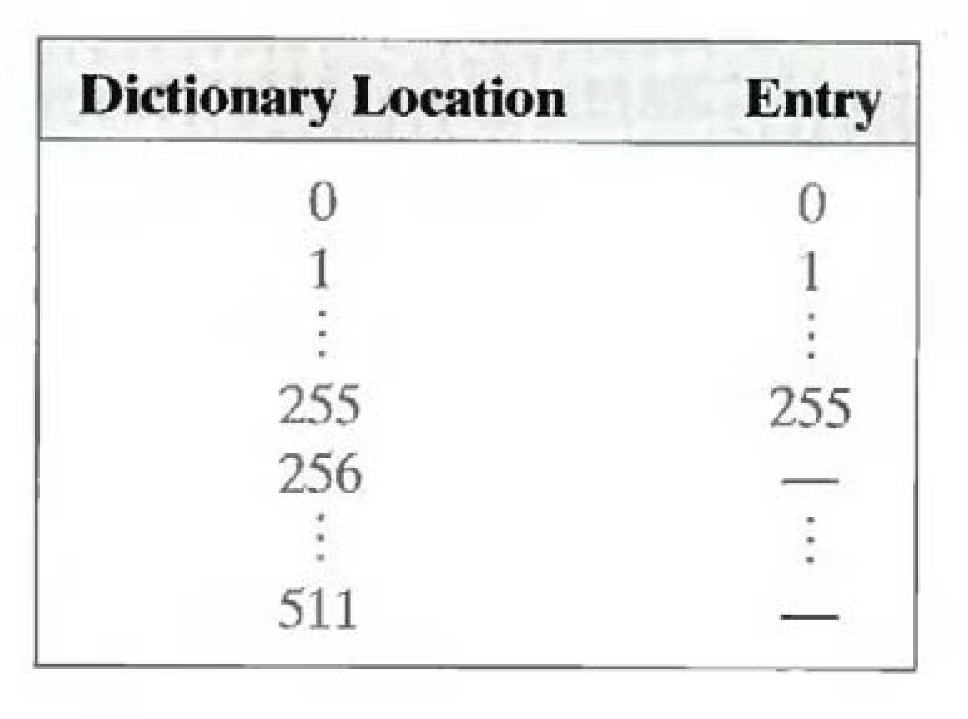
Example – LZW coding
Consider the following 4 x 4, 8-bit image of a vertical edge:
A 512-word dictionary with the following starting content is assumed:
Locations 256 through 511 are initially unused.
The image is encoded by processing its pixels in a left-to-right, top-to-bottom manner.

Slide 31
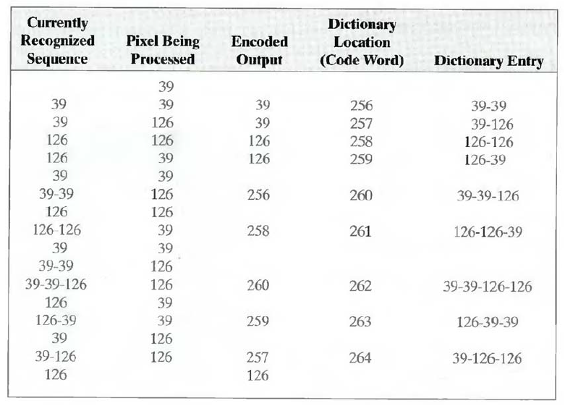
Example – LZW coding
Each successive gray-level value is concatenated with a variable—column 1 of Table called the "currently recognized sequence.“
As can be seen, this variable is initially null or empty.
The dictionary is searched for each concatenated sequence and if found, as was the case in the first row of the table, is replaced by the newly concatenated and recognized (i.e., located in the dictionary) sequence. This was done in column 1 of row 2.

Slide 32
Digital image watermarking
One way to discourage illegal duplication is to insert one or more items of information, collectively called a watermark.
Watermarking is done in such a way that the watermarks are inseparable from the image themselves.
Watermarking is presented when a pattern is inserted in an image, video or audio file, it helps to copyright the information in the files.
Watermark can be visible or invisible

Slide 33
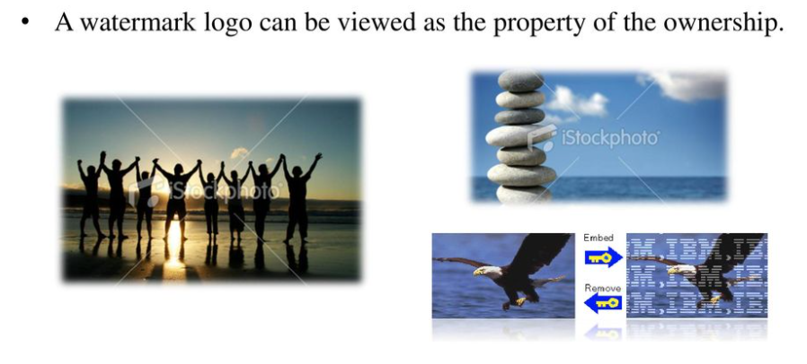
Digital image watermarking
Visible watermark: a visible watermark is an opaque or semi transparent sub image or image that is placed on top of another image.
Television network often place visible watermarks in the upper or lower right hand corner

Slide 34
Digital image watermarking
Letting f_{w} denote the watermarked image, we can express it as a linear combination of the unmarked image f and watermark w using
f_{w}=(1-α)f + αw
Where constant α controls the relative visibility of the watermark and the underlying image.
If α is 1, the watermark is opaque and the underlying image is completely obscured.
As α approaches zero, more of the underlying image and less of the watermark is seen.

Slide 35
Digital image watermarking
pkg load image; clear all; close all;
#Input Image where we want to apply watermark
f=imread('lena_color_512.tif');
#For watermarking, size of inputimage and watermarking image should be same #there for we changed the size of image using imresize and dispalyed
fr=imresize(f,[560 560]);
figure;imshow(fr); title('Original Image with resized');
#Watermarking Image
w=imread('watersample.jpg');
wr=imresize(w,[560 560]);
figure;imshow(wr); title('watermark');
#Applied watermarking
alpha=0.7;
fw=(1-alpha)*fr + alpha.*wr;
#Display the watermarked Image
figure;imshow(fw); title('Watermaked Image');

Slide 36
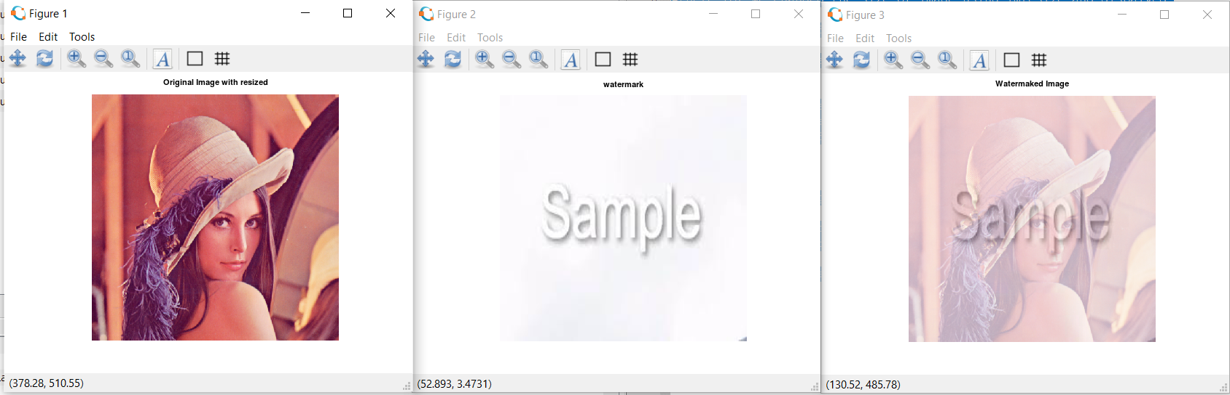
Watermarking -Output

Slide 37

Huff-man coding
pkg load communications
sig = repmat([3 3 1 3 3 2 3 3 2 3],1,3);
symbols = [1 2 3]; p = [0.1 0.2 0.7];
dict = huffmandict(symbols,p);
hcode = huffmanenco(sig,dict);
dhsig = huffmandeco(hcode,dict)
isequal(sig,dhsig)
binarySig = de2bi(sig);
seqLen = numel(binarySig)
binaryhcode = de2bi(hcode);
encodedLen = numel(binaryhcode)

